Slide 1
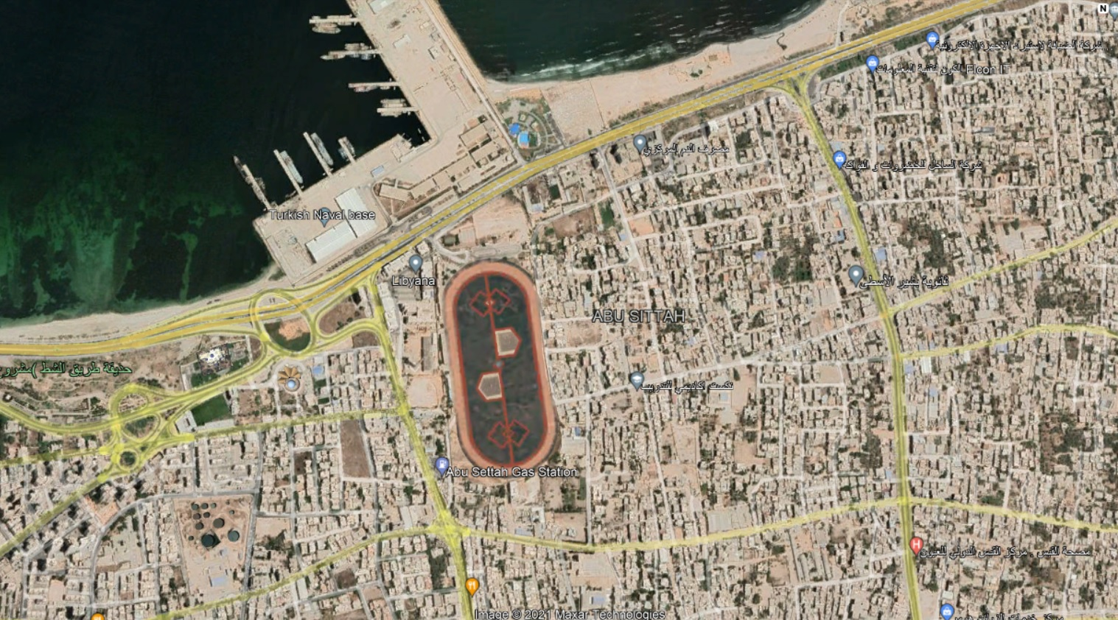
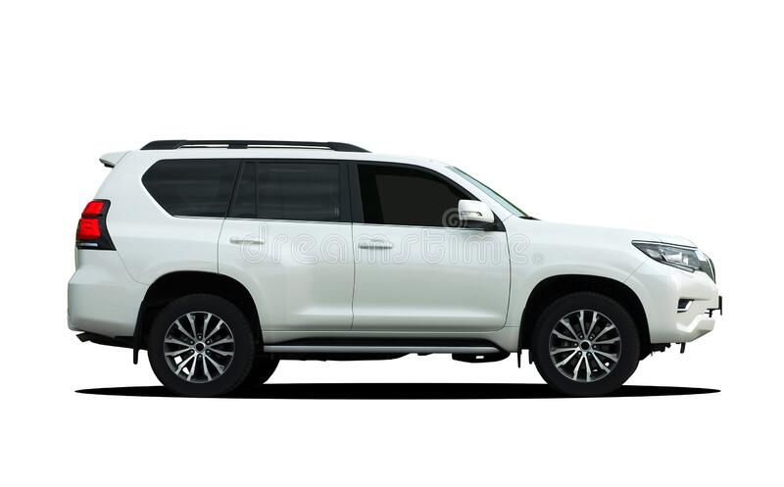
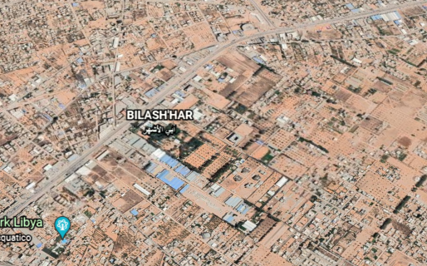
18/10/2021
CPT
SCORTA MTT FS – IPPODROMO
07.30LT – 11.00LT
N
MEZZO TUCSON 5-2227110
C.C. D’ANTONIO MASSIMO
SCP 1°cl sc VOZZA COSIMO
SCORTA MEDICI –PEACOK
08.00LT – 11.00LT
N
MEZZO 25-188316
Cap. Antonio GIUSTO
C°2 Moreno PISCOPIELLO
2°C Vito CAVASINO
SCP 1°cl sc Enrico BERGANTINO

