Slide 1
CPT COURSE
OBJECTIVES
IMPROVE TEAMWORK BRIEFING AND RISK ASSEMENT
RECCE
PLANNING
MOVEMENT
REACTION
ACHIVE ADEQUATE SKILLS IOT ENSURE VIP’s SAFETY AND SECURITY
WEAPON HANDLING CAPABILITIES
HAND TO HAND COMBAT
ABLE TO CONDUCT CLOSE PROTECTION IN MULTIPLE ENVIRONMENT
DISMOUNTED PROTECTION IN URBAN AND BUILDING
ENVIRONMENT
VEHICLE EVASIVE MANEUVERS

Slide 2
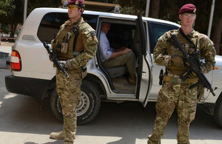
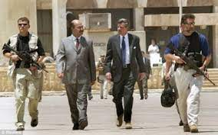
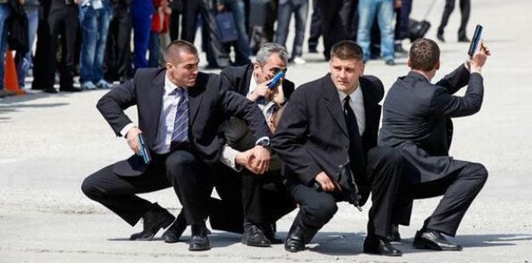
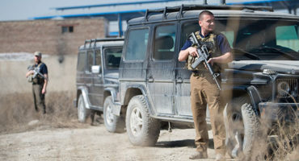
DURATION:
BASIC 24 H
ADVANCED 24 H
ATTENDEES:
N. 5 /10
TRAINERS:
N°3 CPT INSTRUCTOR

