Slide 1
BOARDING TEAM COURSE
OBJECTIVES
ABLE TO CONDUCT COMPLAIN / NO COMPLAIN BOARDING OPERATION
ORGANIZATION
PLANNING
EXECUTION
IMPROVE INDIVIDUAL AND TEAMWORK MARITIME CAPABILITIES
INDIVIDUAL – TEAM SETUP
NAVIGATION DURING BOARDING TEAM OP’s
EMERGENCY PROCEDURES
COMBINED TRAINING ON TTP’s WITH ITALIAN MARINES INSTRUCTORS
MULTIPLE INFIL/EXFIL BOARDING TECHNIQUES
TACTICAL MOVIMENT
WEAPON HANDLING
HAND TO HAND COMBAT
SEARCH
SEIZURE

Slide 2
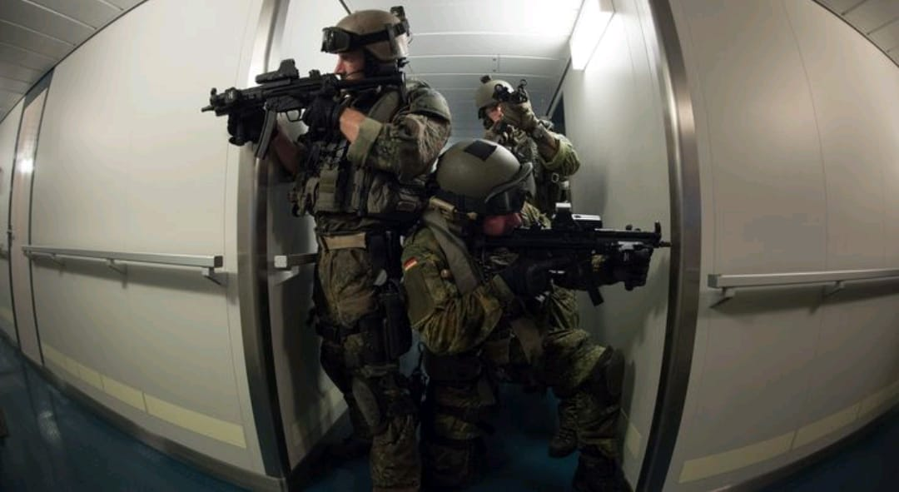
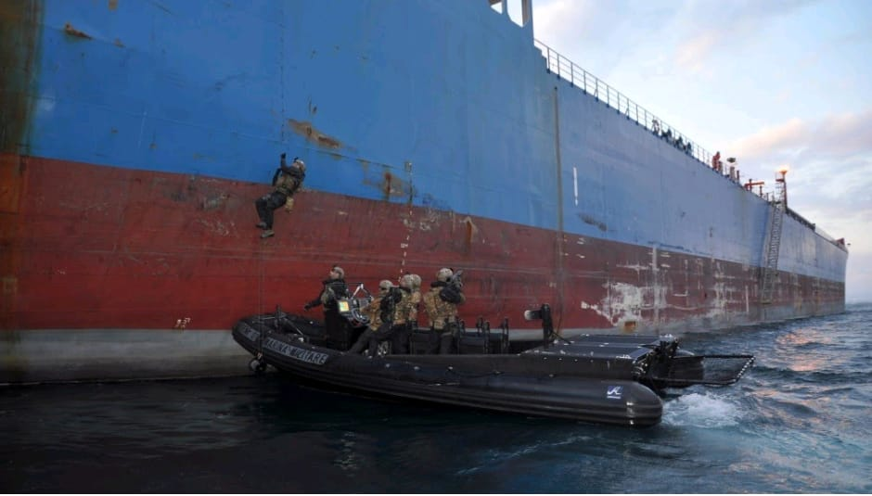
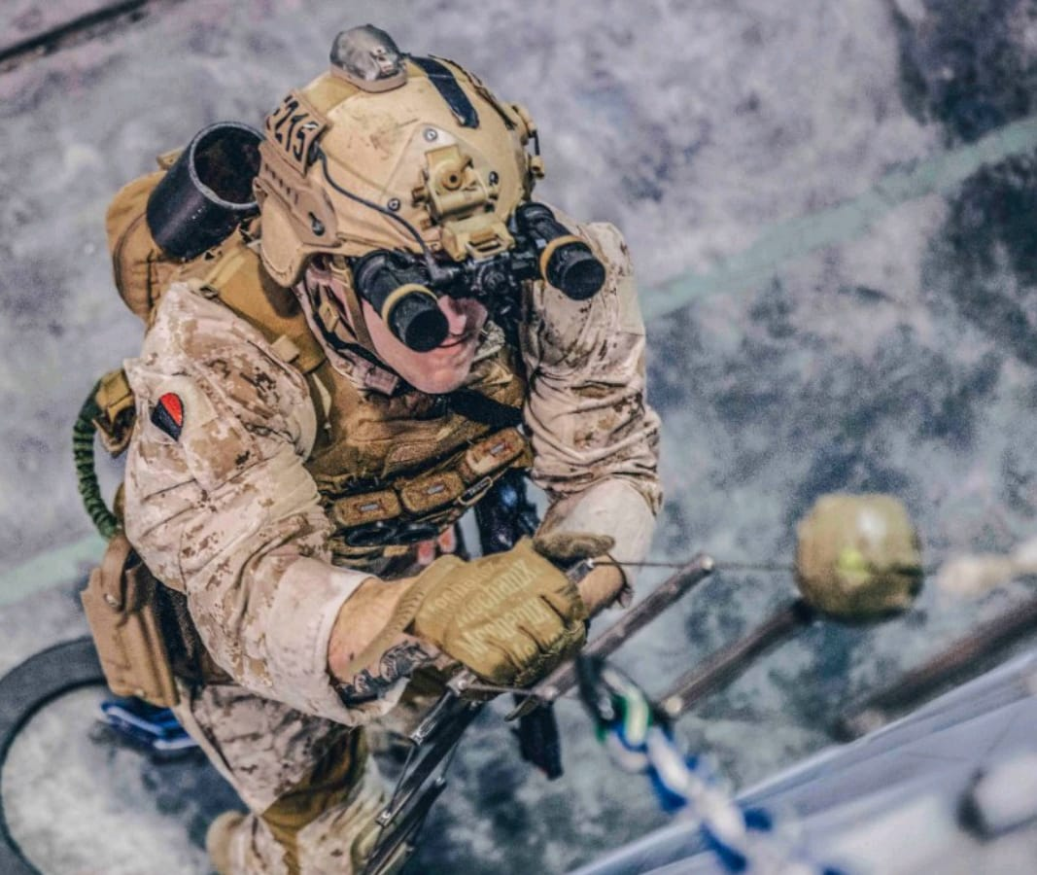
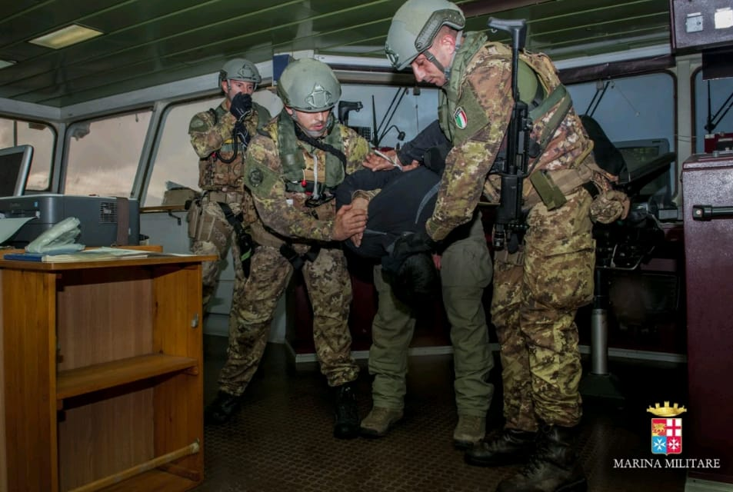
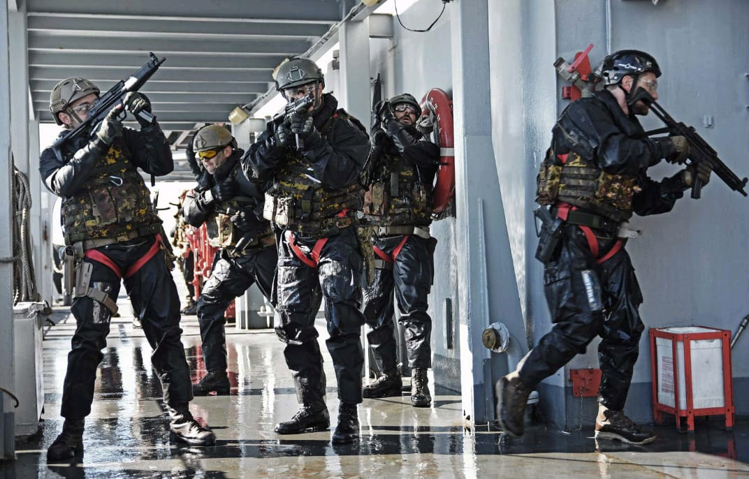
DURATION:
40 hours
ATTENDEES:
N. 5 /10

