Slide 1
CONVOY ESCORT COURSE
OBJECTIVES
IMPROVE PLANNING CAPABILITIES:
TERRAIN ANALYSIS
ROUTE PLANNING
HOW ORGANIZE CONVOY ESCORT
EXPLOIT MOST LIKELY AND MOST DANGEROUS ENEMY C.O.A.
EXTERNAL SUPPORT UNIT.(IED-AIR SUPP)
INDIVIDUAL – VEHICLE
TASK’s
MOBILITY TTP’s
EMERGENCY & LOGISTIC CONTINGENCY
MISSION COMMANDER
VEHICLE SETUP
RECONNAISSANCE VEHICLE
ANTI-AMBUSH DRILLS
VEHICLE FAILURE DRILLS;
IED ATTACK REACTION;
TACTICAL EMERGENCY CASUALTY CARE;

Slide 2
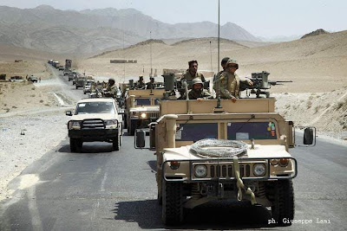
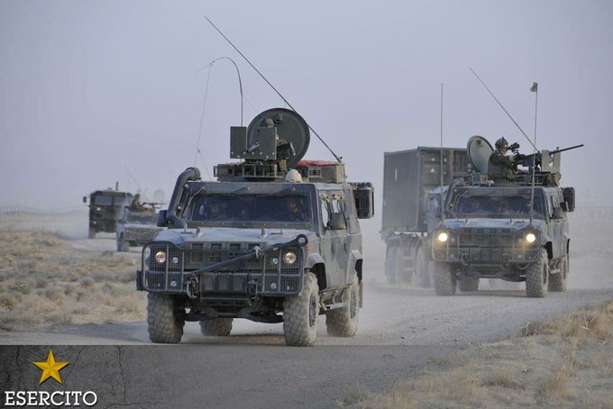
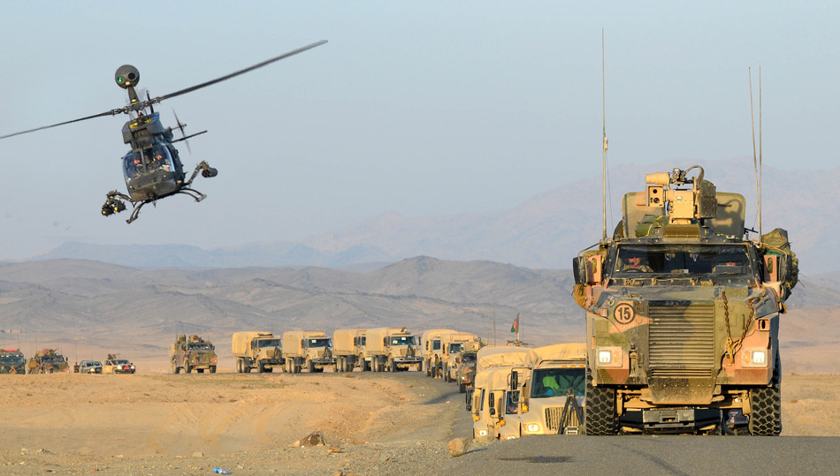
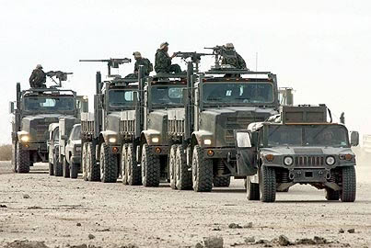
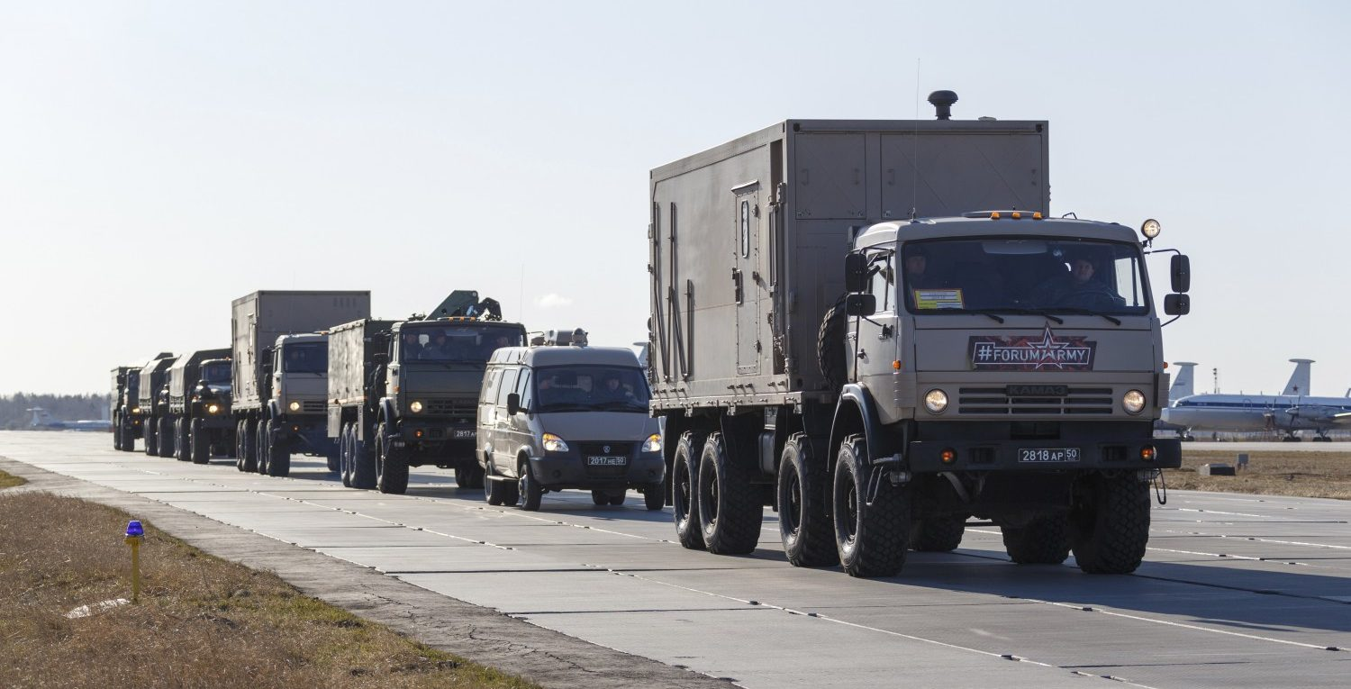
DURATION 24H
TRAINEE 6-10
VEHICLE Min n°3

