Slide 1
ITALY-LIBYA JOINT MILITARY COOPERATION
OBSERVATION & BORDER PATROL STAGE
OBJECTIVES
VEHICLE AND PERSONNEL SEARCH PROCEDURES:
CHECK POINT ORGANIZATION;
PERQUISITION;
PREVENT AND SEIZE SUSPECTED
PERSONNEL;
IMPROVE
MOUNTED AND DISMOUNTED PATROL CAPABILITIES;
PATROL FORMATION;
TROOPS IN CONTACT; IMMEDIATE REACTION;
ACHIEVE SKILLS
IOT:
SETTLE OBSERVATION POST; .
SURVEY ASSIGNED AREA;
INFORMATION REPORT;

Slide 2
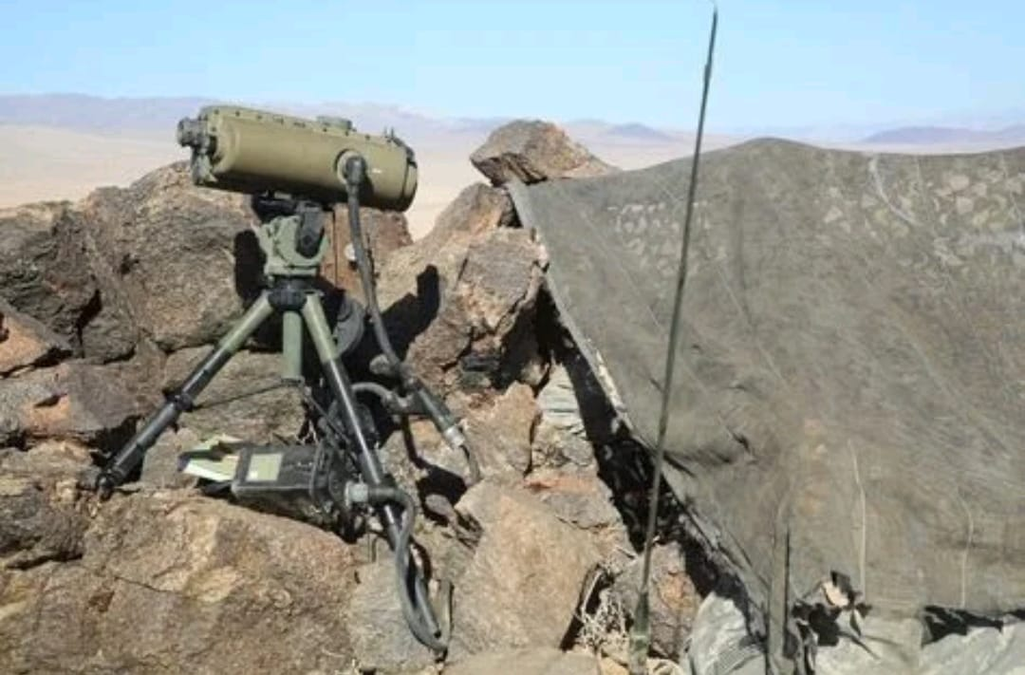
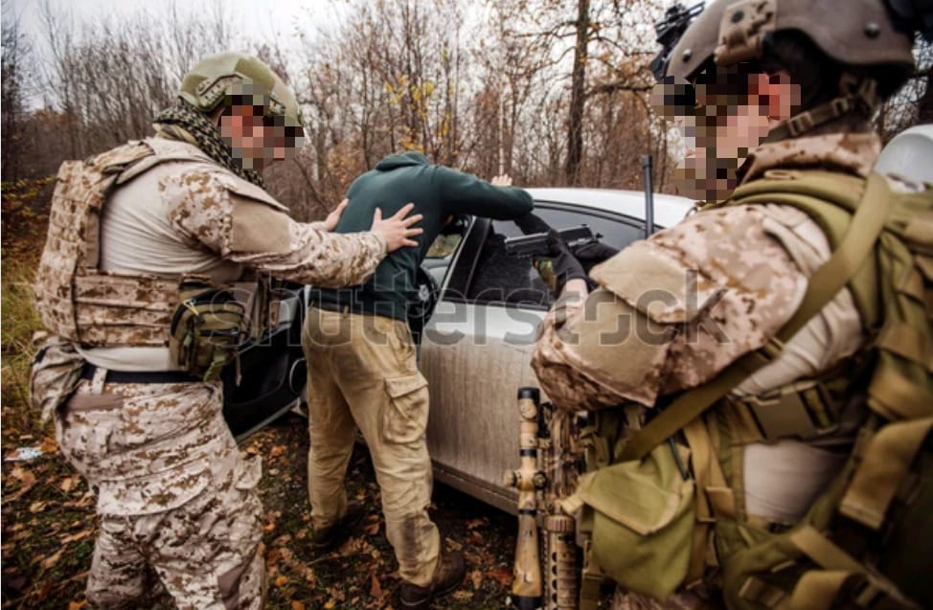
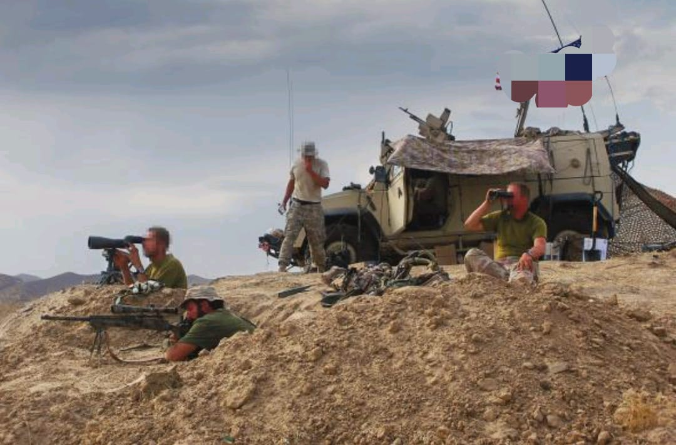
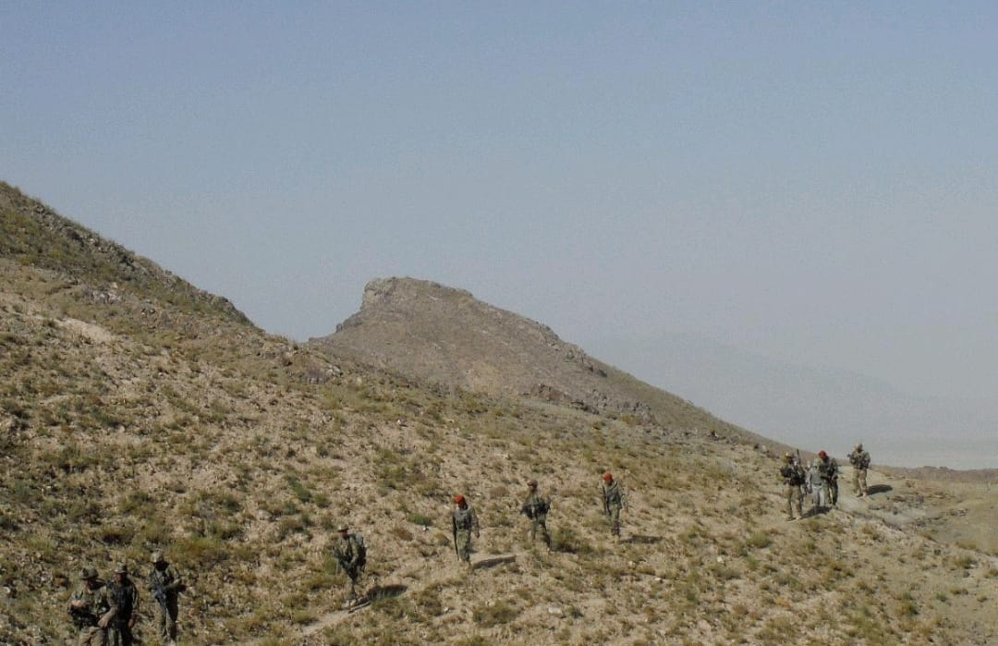
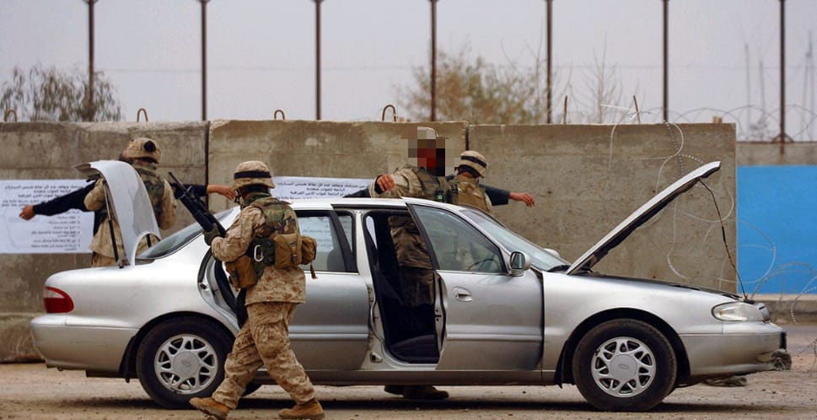
ITALY-LIBYA JOINT MILITARY COOPERATION
OBSERVATION & BORDER PATROL STAGE
ATTENDEES:
N. 10
DURATION:
DISMOUNTED / O.P. MODULE 24 H
MOUNTED / CHECK POINT
TRAINERS:
N°3 INSTRUCTOR

