Slide 1
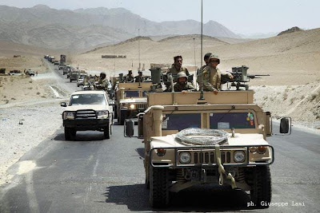
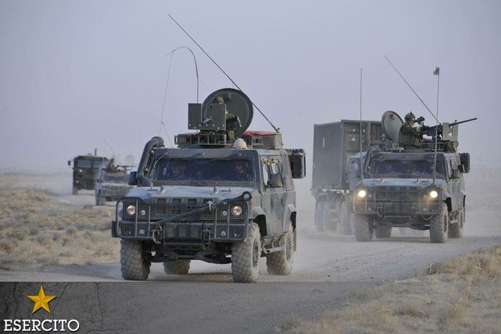
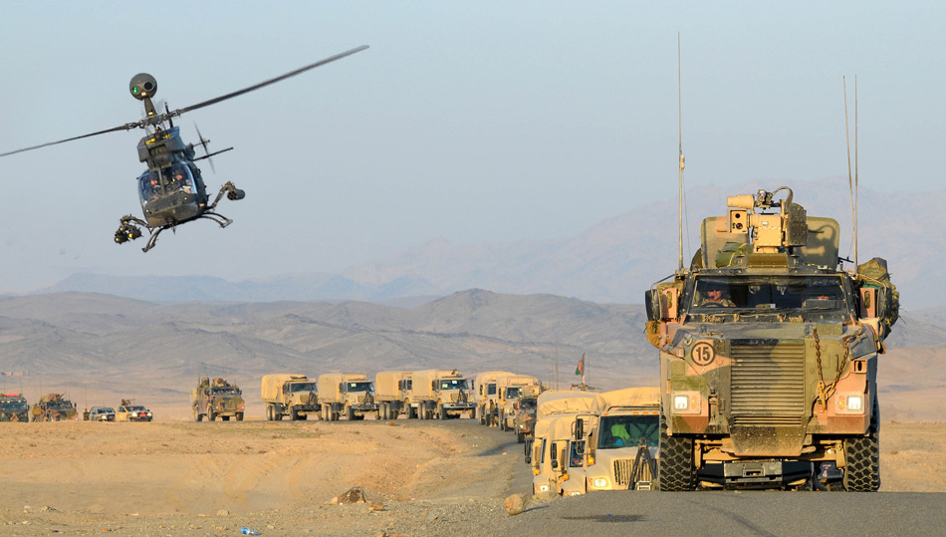
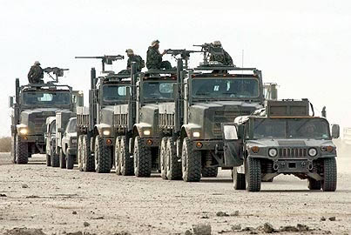
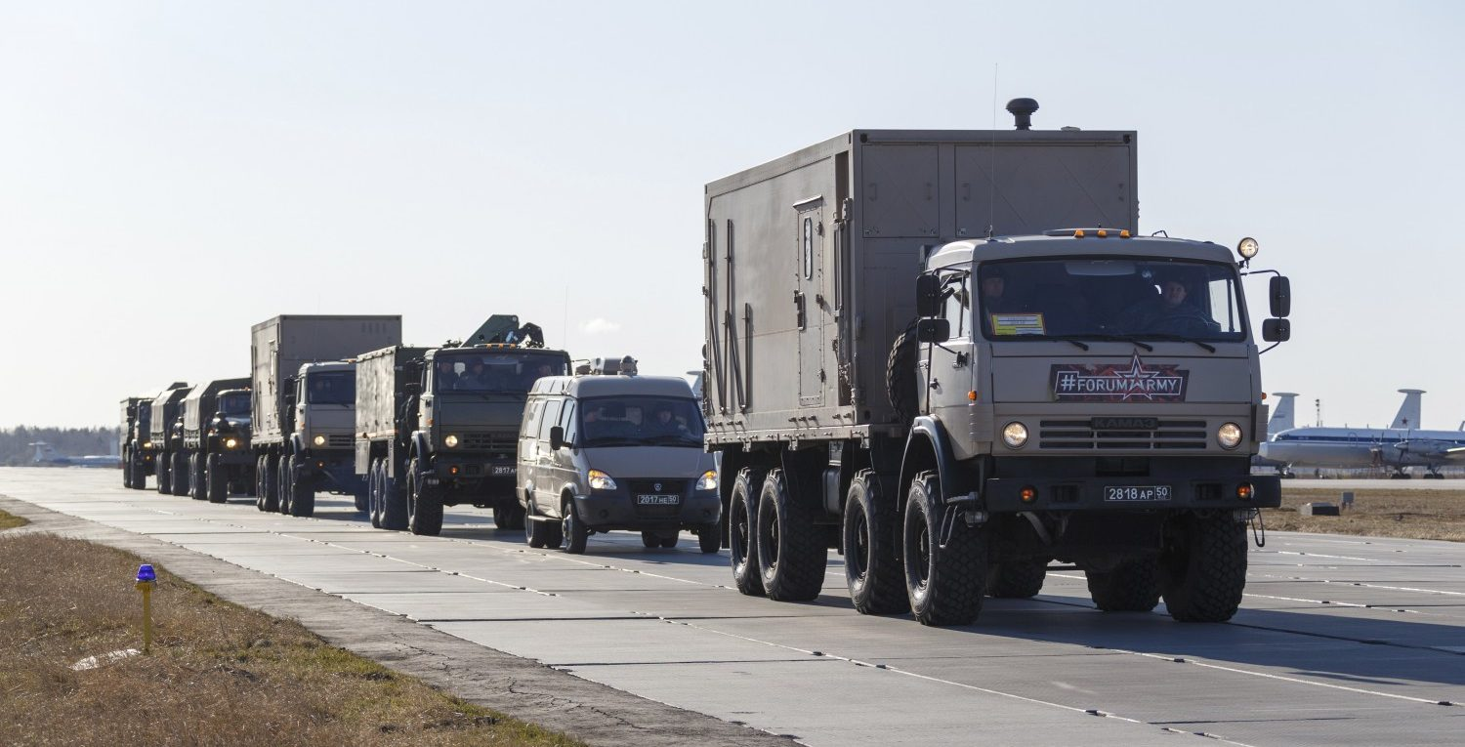
ITALY-LIBYA JOINT MILITARY COOPERATION
CONVOY ESCORT COURSE
DURATION 24H
DURATION 24H
TRAINEE 6-10
VEHICLE Min n°3

Slide 2
ITALY-LIBYA JOINT MILITARY COOPERATION
CONVOY ESCORT COURSE
OBJECTIVES
IMPROVE PLANNING CAPABILITIES:
TERRAIN ANALYSIS;
ROUTE PLANNING;
HOW ORGANIZE CONVOY ESCORT;
EXPLOIT MOST LIKELY AND MOST DANGEROUS ENEMY C.O.A.;
EXTERNAL SUPPORT UNIT.(IED-AIR SUPP);
INDIVIDUAL – VEHICLE
TASK’s
MOBILITY TTP’s
EMERGENCY & LOGISTIC CONTINGENCY
MISSION COMMANDER;
VEHICLE SETUP;
RECONNAISSANCE VEHICLE;
ANTI-AMBUSH DRILLS;
VEHICLE FAILURE DRILLS;
IED ATTACK REACTION;
TACTICAL EMERGENCY CASUALTY CARE;

