Slide 1
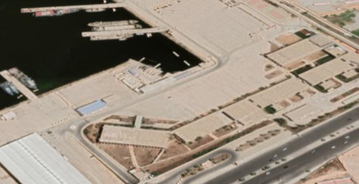
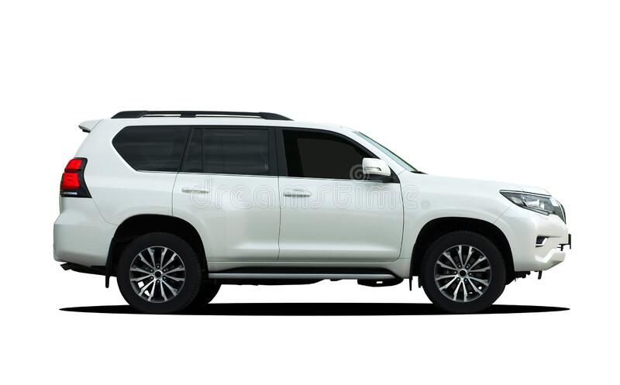
MIASIT
CPT
10.30lt – T.E. ALWADDAN –VTC ABU SITTAH
MEZZO 5-2255823 (LAND ROVER)
CA. Placido TORRESI
TV. Davide LUNETTO
2°C Vito CAVASINO
Int. Aimen BATRUMA

