Slide 1
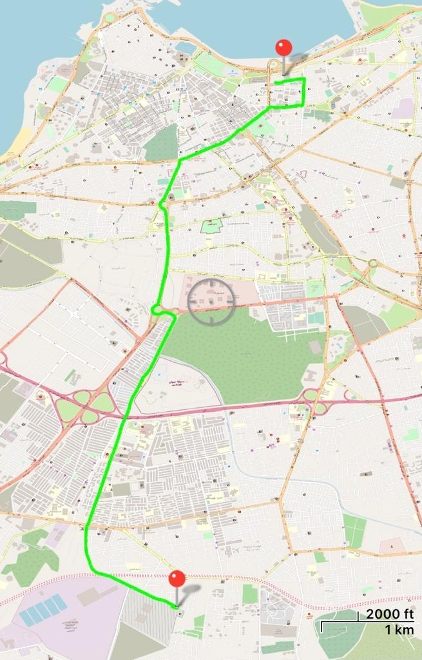
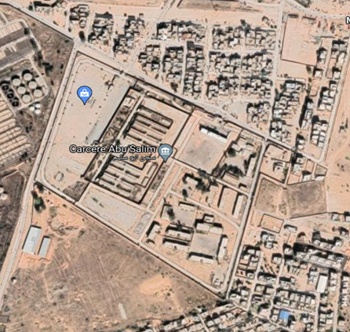
COORD: 33S US 29430 34312
DISTANZA: 9 KM
TEMPO PERC.: 20’

Slide 2
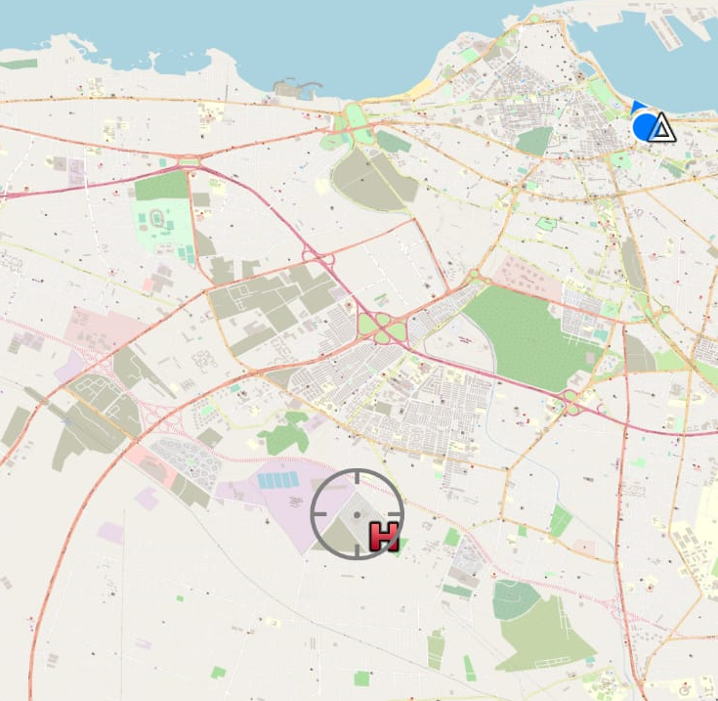
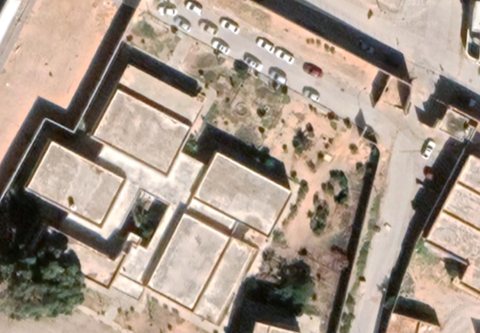
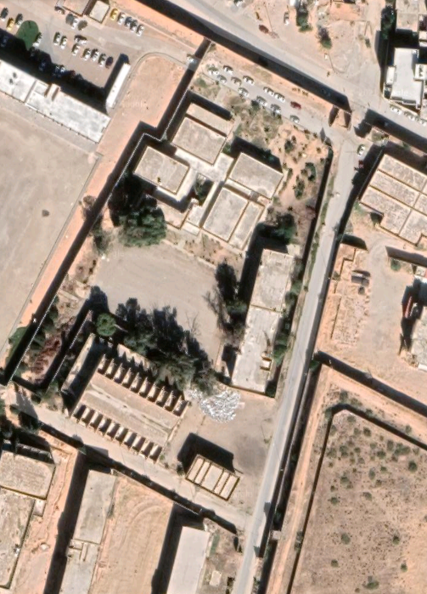
CPT
PEDESTRIAN
GATE
MAIN GATE
N
ACC. B.G.
N
33S US 29430 34312

Slide 3
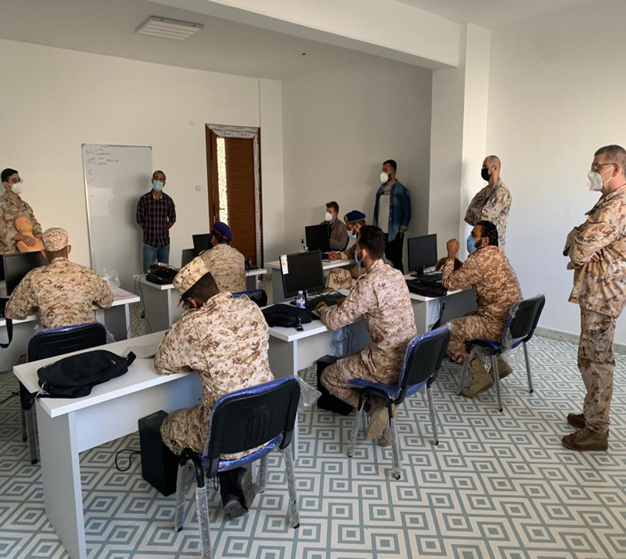
CPT
PEDESTRIAN
GATE
MAIN GATE
AULA LEZIONI MOBILE MEDICAL TEAM

