Slide 1
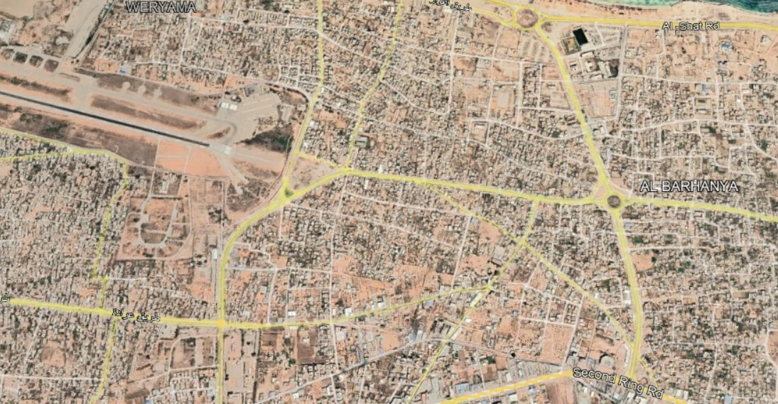
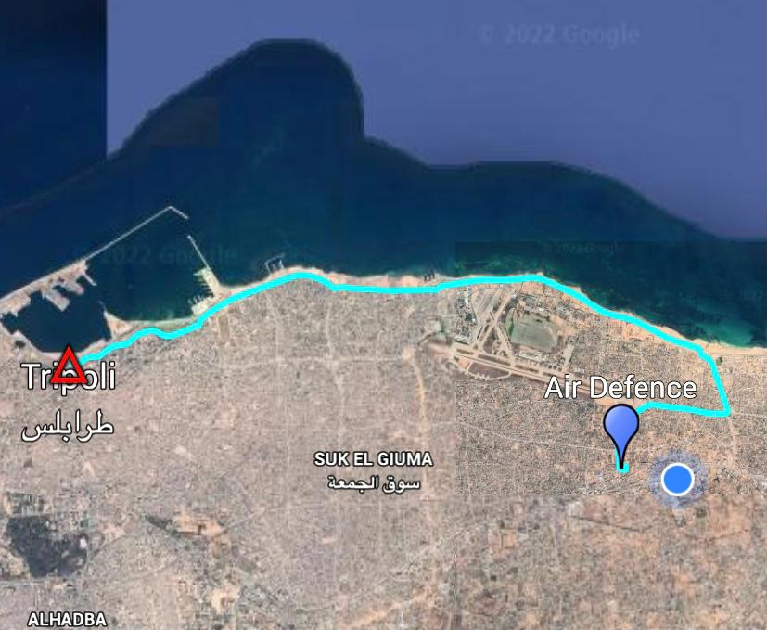
CPT
AIR DEFENCE
N
Miasit
AIR DEFENCE
33S US 31530 38862
DIST: 17 KM
TEMPO PERC. 30’

Slide 2
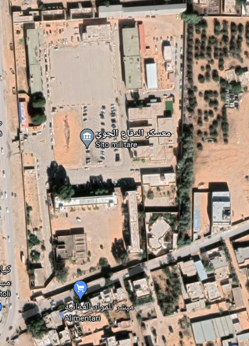
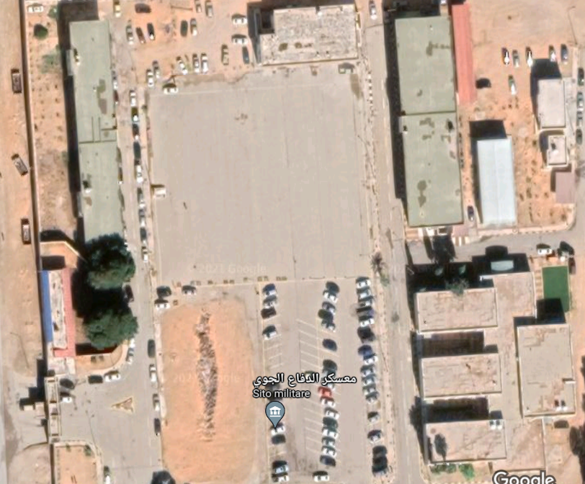
UFF. COOP.
MAIN GATE
N
UFF. GEN.

